Slide 1
Fundamental Rights and Freedoms
Key Stage 4

Slide 2

TRUE or FALSE?
01
02
03
A ‘right’ is a moral or a legal entitlement to have or do something
Human rights are entitled to residents of a specific country only
People have the right to say whatever they want
04
All people have equal rights
05
Do children have their own special rights, as well as other human rights?
Notes:
A ‘right’ is a moral or a legal entitlement to have a do something
Human rights are for people living only in Maldives.
People have the right to say whatever they want.
All people have equal rights.
Do children have their own special rights, as well as other human rights?

Slide 3
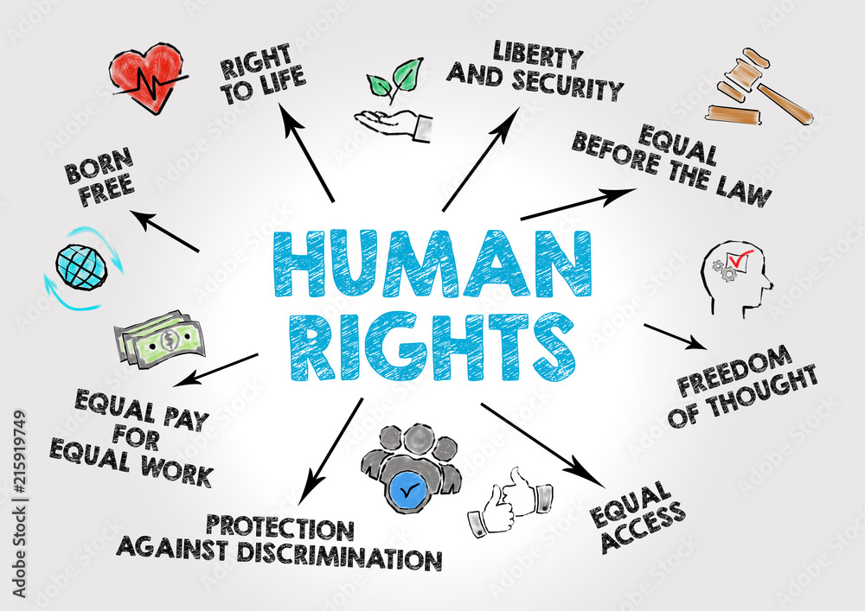
Definition:
Rights
; fundamental entitlements or privileges that individuals possess by virtue of being human. These rights are typically protected and recognized by laws, ethical principles, or social norms.

Slide 4
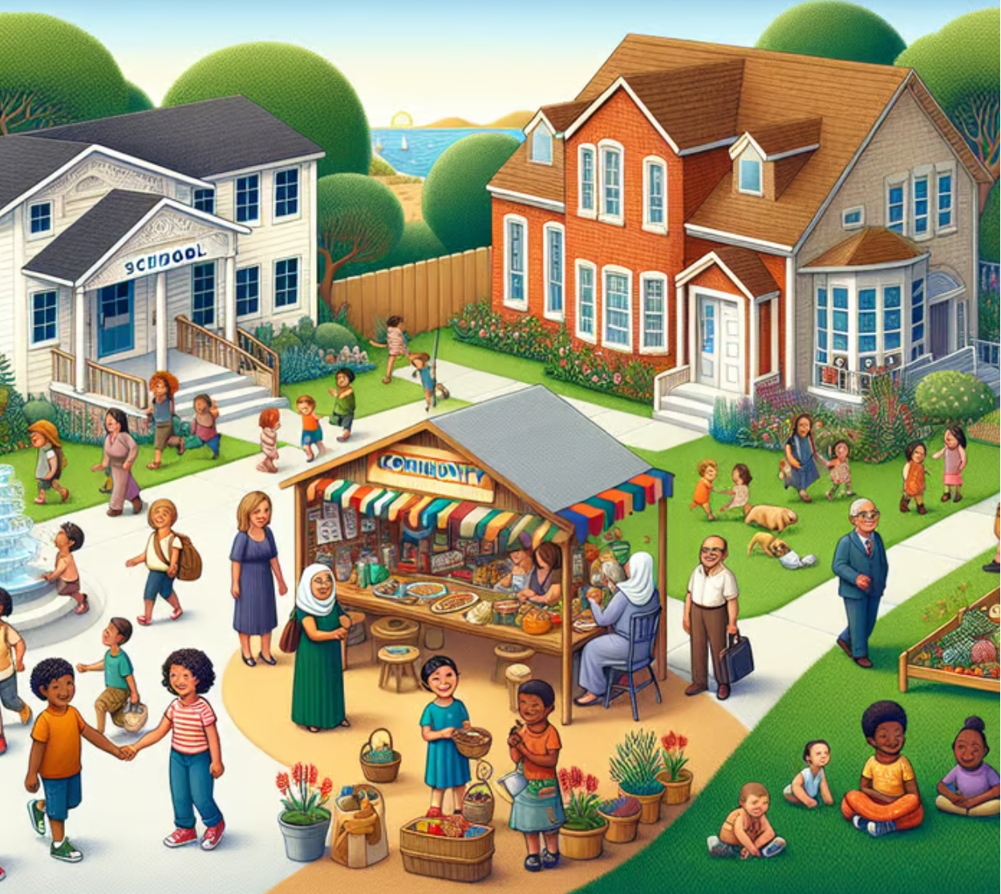
Importance:
Fundamental rights and freedom are necessary for a nation
for the growth of every individual
for safeguarding peoples’ interests
serve as the nation’s backbone
Notes:
Fundamental rights and freedom are necessary for a nation for the growth of every individual and also for safeguarding peoples’ interests. They are crucial for the government in the sense that they serve as the nation’s backbone. In difficult times, citizens can be protected by their rights.

Slide 5
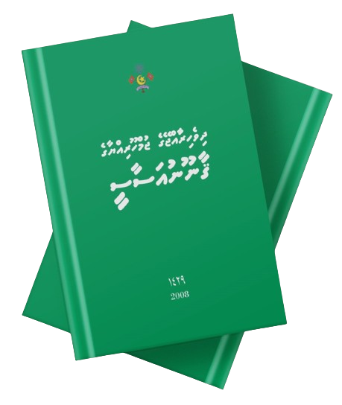
The Constitution of Maldives enumerates the fundamental rights and freedoms for every Citizen.

Slide 6

What are some fundamental rights ensured by the Constitution of Maldives?
Individual Rights and Freedoms
  Freedom from restraint
  Equality
  Privacy
  Freedom of expression
  Right to life
Social and Economic Rights
  Economic and social rights
  Freedom from acquiring and imparting knowledge
  Special protection to children, young, elderly, and disadvantaged people
Civil and Political rights
  Right to vote
  Freedom of Assembly and Association
Notes:
Individual Rights and Freedoms:
Freedom from restraint - One is free to engage in any conduct or activity that is not expressly prohibited by Islamic Shari’ah or by law.
Equality - Everyone is equal before and under the law and has the right to equal protection and equal benefit of the law.
Privacy - Everyone has the right to respect their private and family life.
Freedom of expression - Everyone has the right to freedom of thought and the freedom to communicate opinions and expression in a manner that is not contrary to any tenet of Islam.
Right to life - Everyone has the right to life, liberty and security.
Social and Economic Rights
Economic and social rights - Everyone has the right to nutritious food and clean water, clothing and housing, better health care, a healthy and ecologically balanced environment, equal access to means of communication, the establishment of an adequate sewage system, and the establishment of electricity.
Freedom from acquiring and imparting knowledge - Everyone has the right and freedom to acquire and impart knowledge, information and learning.
Special protection to children, young, elderly, and disadvantaged people - Children and young people, elderly and disadvantaged people are entitled to special protection and special assistance from the family, the community and the State.
Civil and political rights
Right to vote - Every individual above eighteen years of age, has the right to vote in elections, and in public referendums.
Freedom of Assembly and Association: The right to gather and associate with others for peaceful purposes.

Slide 7

Video Credit: Learn Bright

Slide 8
Chapter 2, Article 67:
The exercise and enjoyment of fundamental rights and freedoms is inseparable from the performance of responsibilities and duties
State
Citizen
RIGHTS
RESPONSIBILITIES
Notes:
Brainstorm the student about rights and responsibilities
The entitlements and duties as citizens.
Rights are freedoms that are protected legally.
Responsibilities are things you should do.
Unlike the USA, Maldives, does not have a national Bill of Rights that officially protects our rights

Slide 9



Responsibilities of Citizens:
to uphold and defend the rights and freedoms of others
to encourage tolerance, respect, and friendship among all individuals and groups
to contribute to the community's advancement and well-being

Slide 10



Responsibilities of Citizens:
to advance the Maldives' sovereignty, unity, security, integrity, and dignity
to respect the Constitution and the rule of law
to advance democratic values and practices in a way that does not conflict with any Islamic tenet

Slide 11



Responsibilities of Citizens:
To safeguard and uphold the State religion of Islam, culture, language, and heritage of the nation
to preserve and protect the country's natural environment
to respect the national flag, state emblem and the national anthem

Slide 12
Major conventions signed and ratified by our country:
The Convention on the Elimination of all forms of Racial Discrimination (ICERD)
The International Covenant on Civil and Political Rights (ICCPR)
The International Covenant on Economics, Social and Cultural Rights (ICESCR)
The Convention on the Elimination of all forms of Discrimination against Women (CEDAW)

Slide 13
Major conventions signed and ratified by our country:
The Convention against Torture and other Cruel, Inhumane or Degrading Treatment or Punishment (CAT)
The Convention on the rights of the Child (CRC)
The Convention on the rights of Persons with Disabilities CRPD)

Slide 14

Activity
Scenario
The government passed a new law restricting freedom of expression, censoring any criticism of government policies or officials. Simultaneously, they imposed strict regulations on media outlets, requiring them to obtain government approval before publishing any content. When workers from various industries organized a peaceful strike to demand better working conditions, the government declared it illegal and deployed riot police to forcefully disperse the protesters, arresting several organizers. As dissenters voiced their concerns online, authorities swiftly shut down social media platforms and arrested those who dared to defy the censorship.

Slide 15
Questions:
Have any fundamental rights been violated here? If so, which rights?
Is there anything the protestors can do about this issue?

